Slide 1
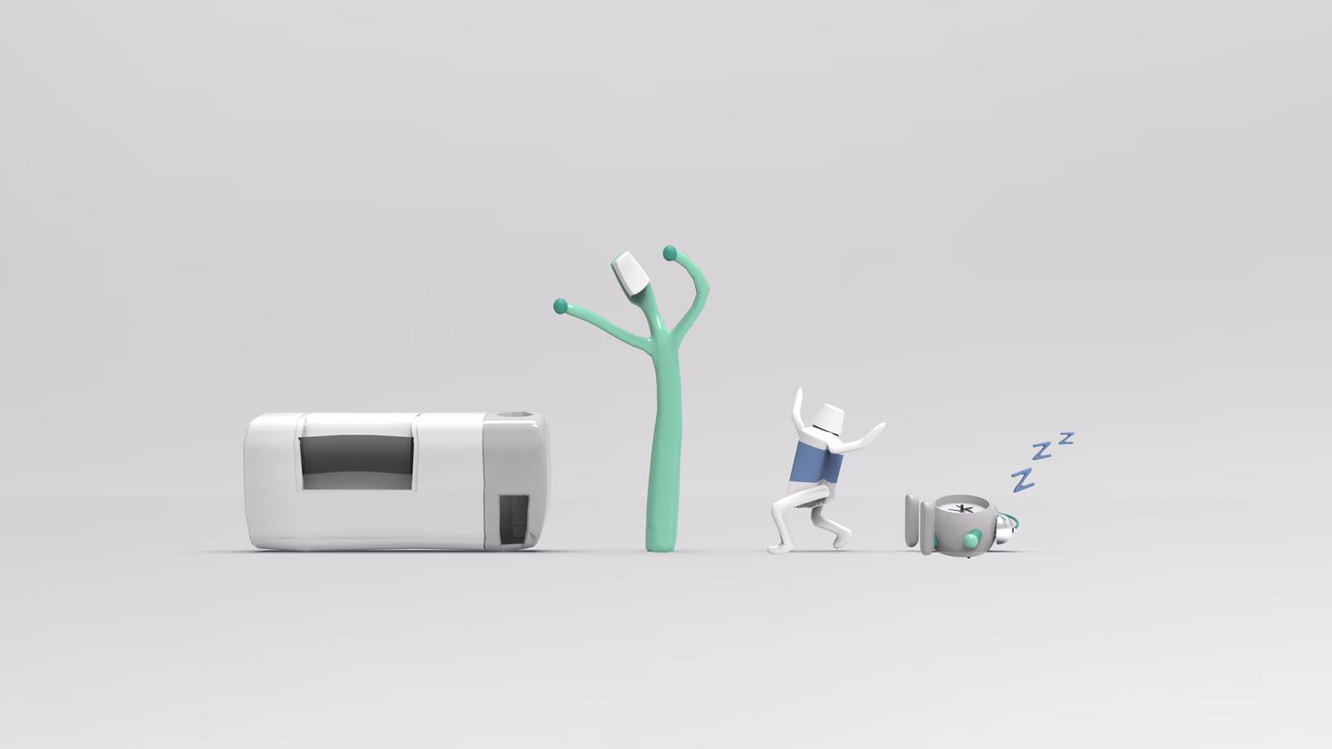
SMART
CONT
AINER
Team MorningTide Final Presentation

Slide 2

who
is it for?
If you want to have a better morning, this might be what you want

Slide 3
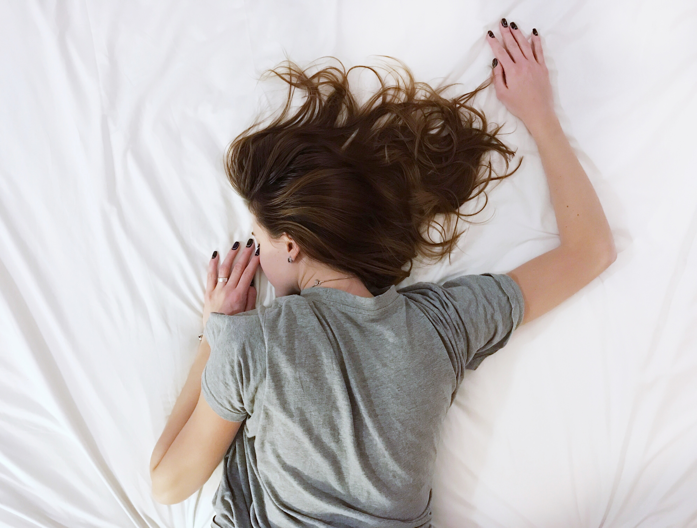
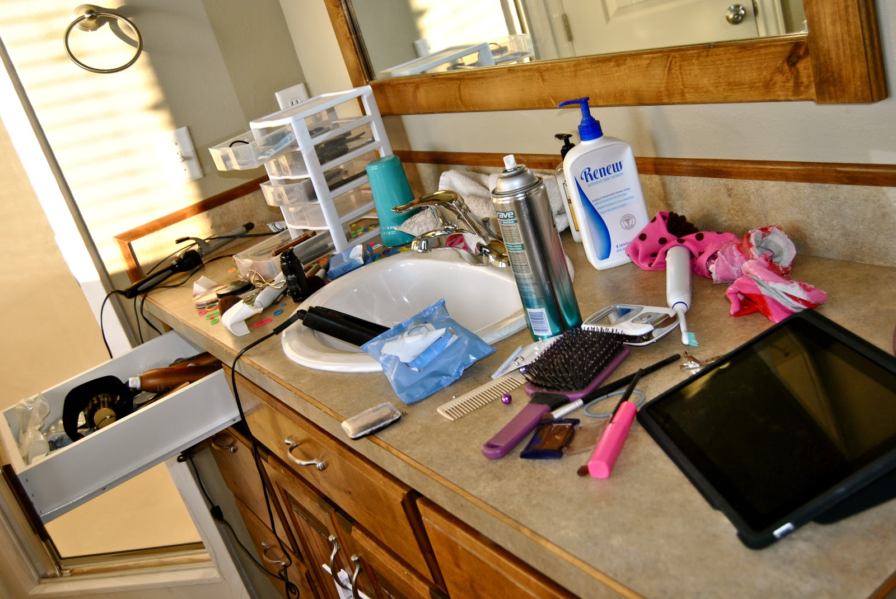
Find it hard to wake up in the morning?
Always sleep through the alarm?
Set up 5 alarms to make sure you won' t be late for work?
Washbasin is always a mess?
Always overwhelmed by the products you use in the morning?
Want to put your toothbrushes and toothpaste in place and keep them clean?

Slide 4
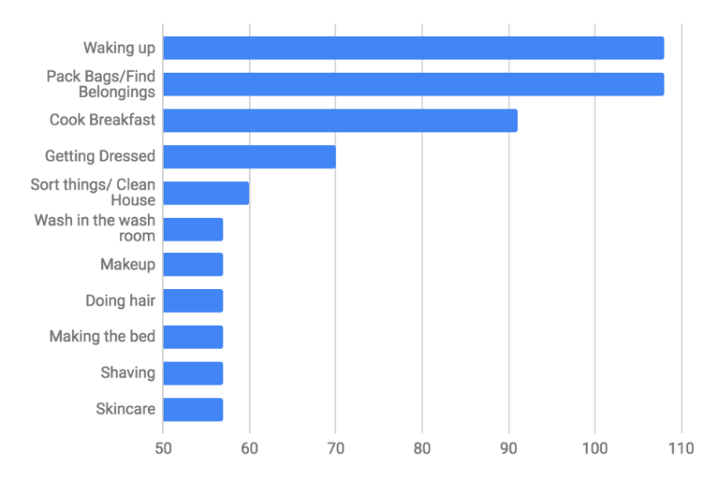
waking up is the hardest amongst all morning routine

Slide 5

target customers
Office Workers & Students
Hotel Customers
problem definition
A better solution for waking up in the morning
An organizer to keep bathroom tidier and cleaner

Slide 6

what
does it do?

Slide 7
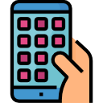



key features
App Control
Wakeup Alarm
+ Phone holder
Toothbrush Sanitizer
Toothpaste Squeezer

Slide 8
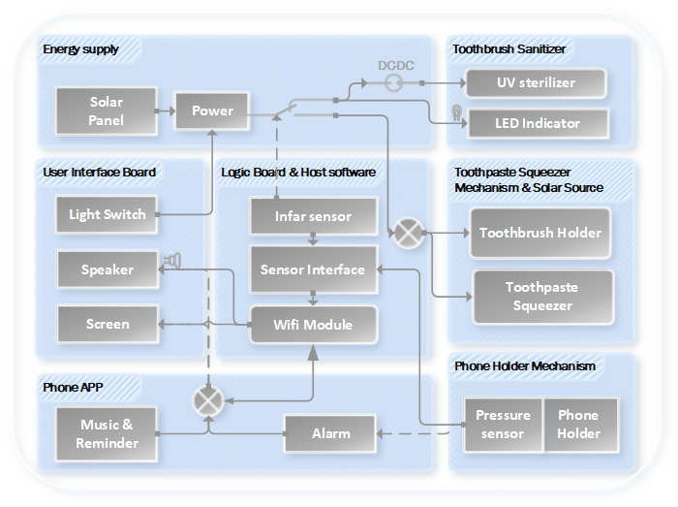
cfp glassbox

Slide 10
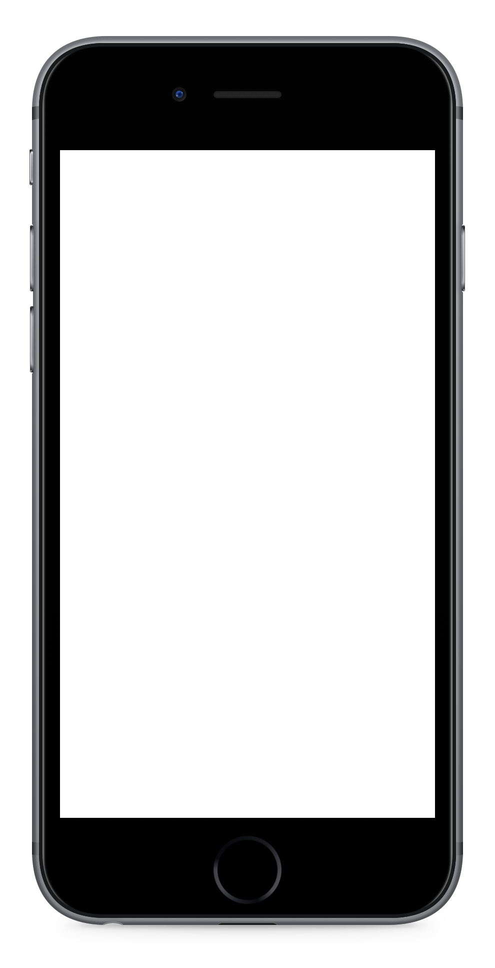
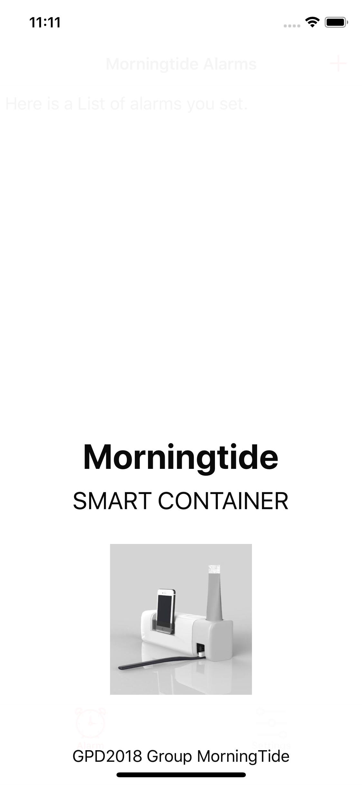
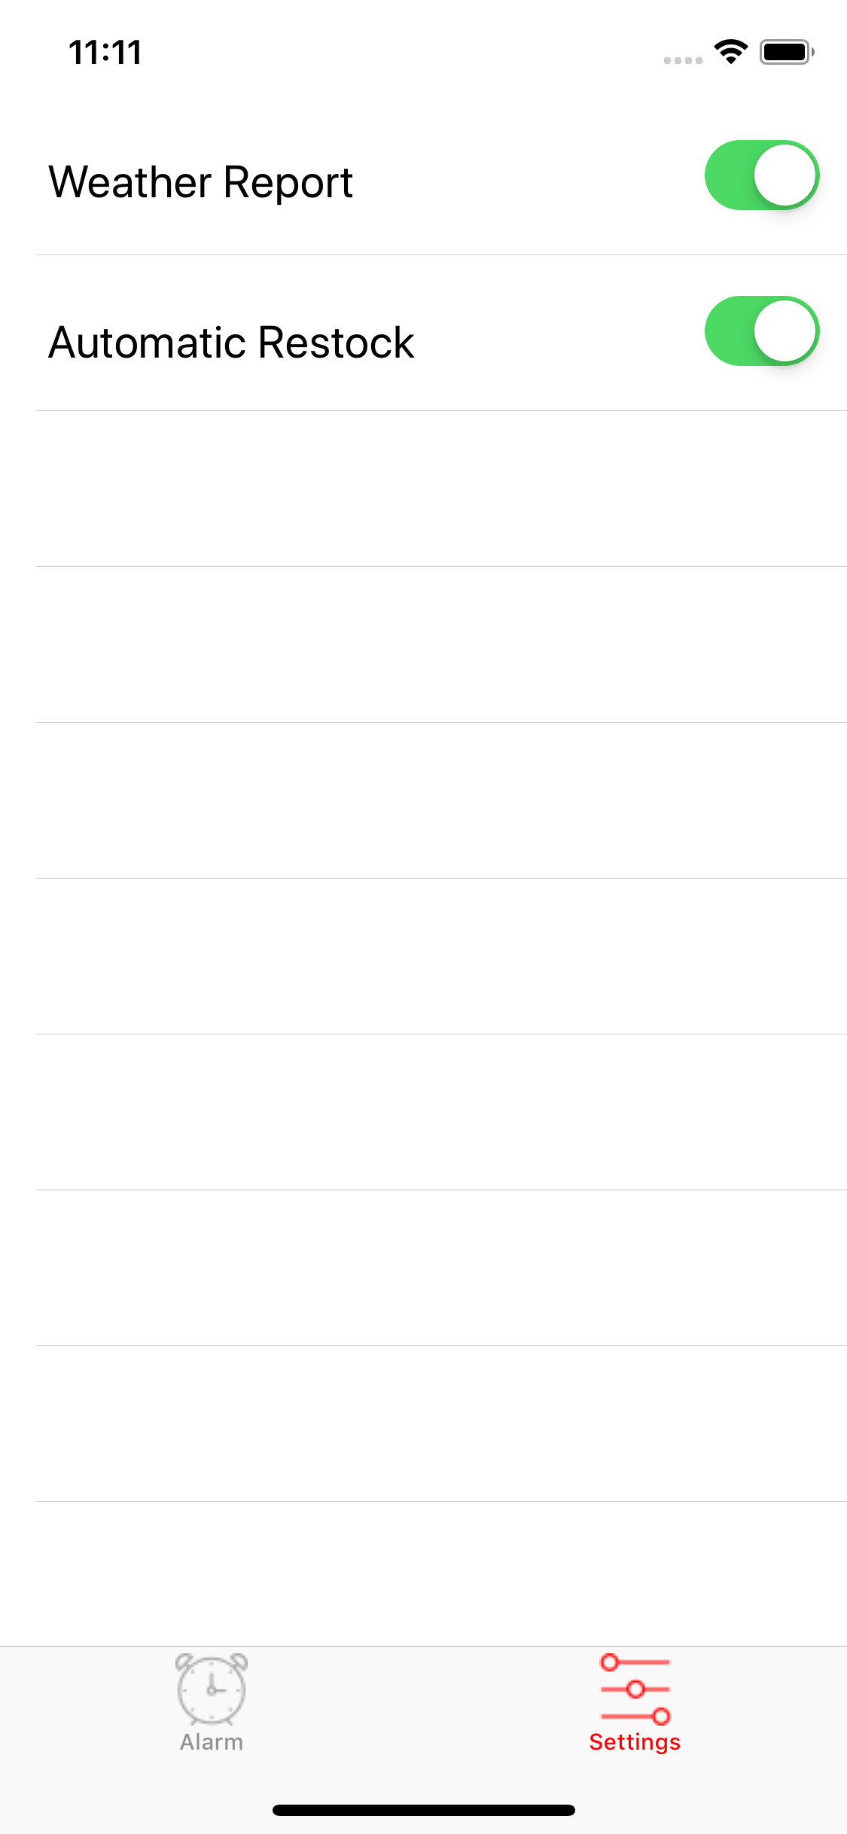
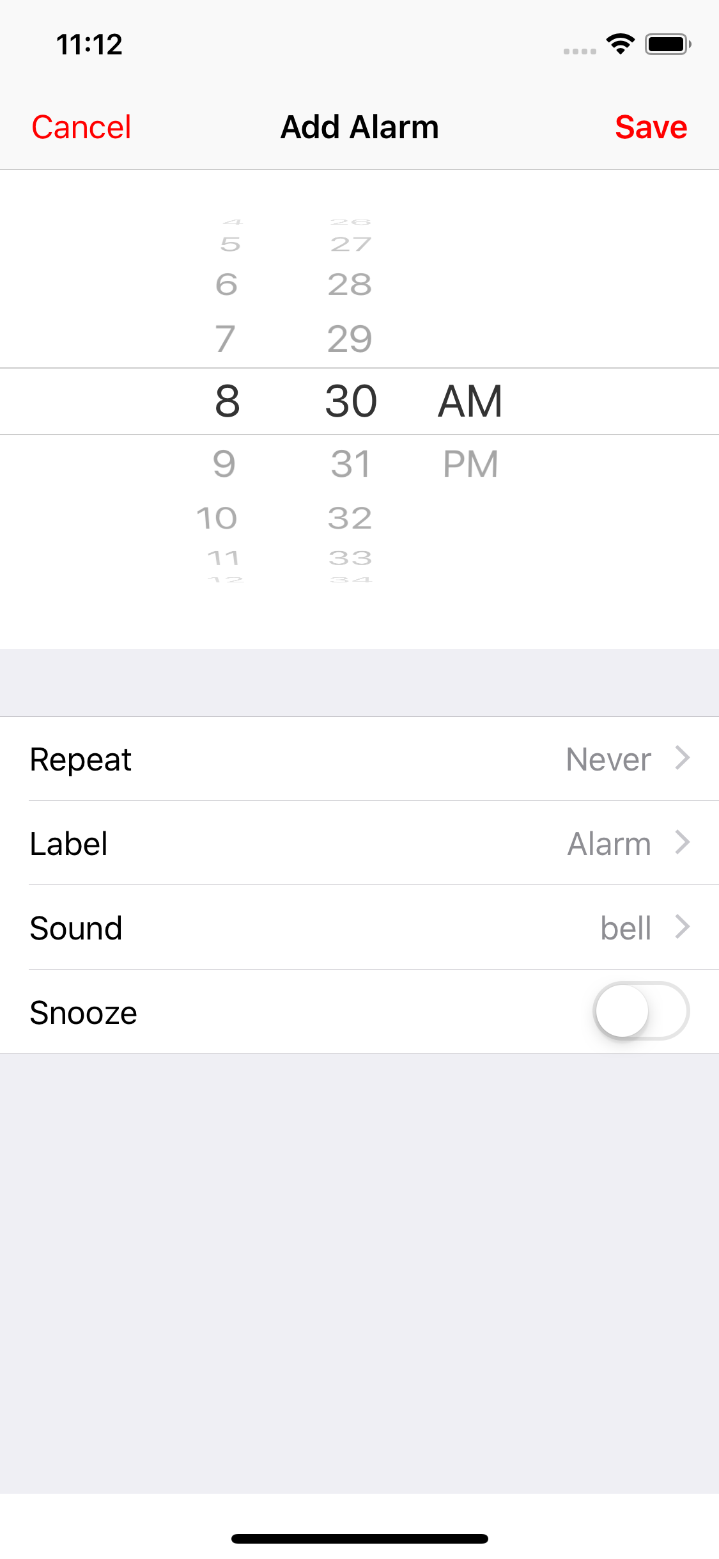
ALARM CONTROL
Add and edit alarm:
Set repeat, sound, snooze
REMINDER SETTINGS
Set the reminder for the morning
Weather report, music players or other features
cfp glassbox

Slide 11
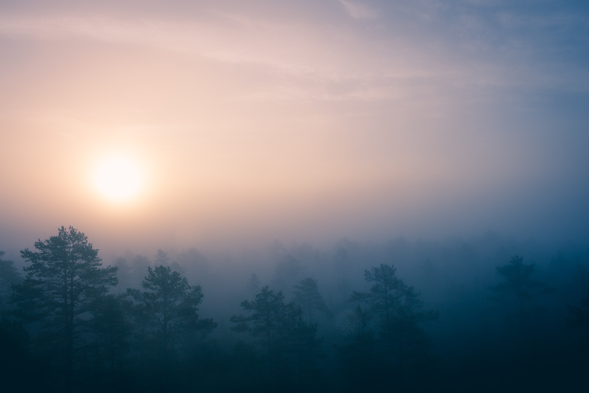
why
we need it?

Slide 12
evaluation matrix
 | Engineering Metrics
 | Area | Energy |  |  | Geometry |  | Modules |  |  |  | Coating |  | Appearance | Motion |  | Sound |  | Physical controls |  | APP controls
 | Customer Weights | endurance | consumption | charging | Dimension | Shape | Phone | Customization | Amount | Special function | Waterproof | Antiskid | Attractive | Rapid | Moving distance | phone speaker | product speaker | buttons | touch screen | check product amount
Customer Requirements
Design makes the product attractive | 9 |  |  |  |  | 9 | -3 |  |  |  |  |  | 9 |  | 3 |  | -3 | 3 | 6 | -3
portable | 1 |  |  |  | 9
Small enough to fit in the sink/on the wall | 9 |  |  |  | 9
Modular | 6 |  |  |  |  |  | -3 | 9 | 6 | -3 |  |  |  |  |  |  | 3
customized/special modular(for toothbrush, toothpaste, etc.) | 6 |  |  |  |  |  | 6 | 9 |  | 9
easy disassembly | 6 |  |  |  |  |  |  |  |  | -3 | 9 |  |  |  |  |  | -6 | -3 | 3 | -3
Battery Storage, Home supply | 4 | 9 | 3 | 9 | -3
hygiene | 8
quick fetch | 9 |  |  |  |  |  |  |  |  | 6 |  |  |  | 9 | 6
Bathroom: Humid, narrow space, room temperature | 7 |  |  |  |  |  |  |  |  |  | 9 | 6
Wakeup Alarm | 9
Alarm clock stop automatically upon completing of the necessary washing routine | 8
APP control | 6
Clock & Weather report | 1
Memo& Notification | 5 |  |  |  |  |  |  |  |  |  |  |  |  |  |  |  |  |  |  | 9
customized alarm | 3 |  |  |  |  |  |  |  |  |  |  |  |  |  |  |  |  |  |  | 6
Automatic bathroom supplies purchasing | 1 |  |  |  |  |  |  |  |  |  |  |  |  |  |  |  |  |  |  | 6
Record and analysis of product consumption | 6 |  |  |  |  |  |  |  |  |  |  |  |  |  |  |  |  |  |  | 6
Play Music | 4 |  |  |  |  |  |  |  |  |  |  |  |  |  |  |  | 9 |  |  | 6
Less than 30 USD | 6
Sum | Raw score | 36 | 12 | 36 | 78 | 81 | -9 | 108 | 36 | 72 | 117 | 42 | 81 | 81 | 81 | 0 | -9 | 9 | 72 | 84
1008 | Relative Weight | 4% | 1% | 4% | 8% | 8% | -1% | 11% | 4% | 7% | 12% | 4% | 8% | 8% | 8% | 0% | -1% | 1% | 7% | 8%
 | Rankings | 11 | 15 | 11 | 7 | 4 | 18 | 2 | 11 | 9 | 1 | 11 | 4 | 4 | 3 | 17 | 18 | 16 | 8 | 20
Conceptual Market Review - MorningTide

Slide 13
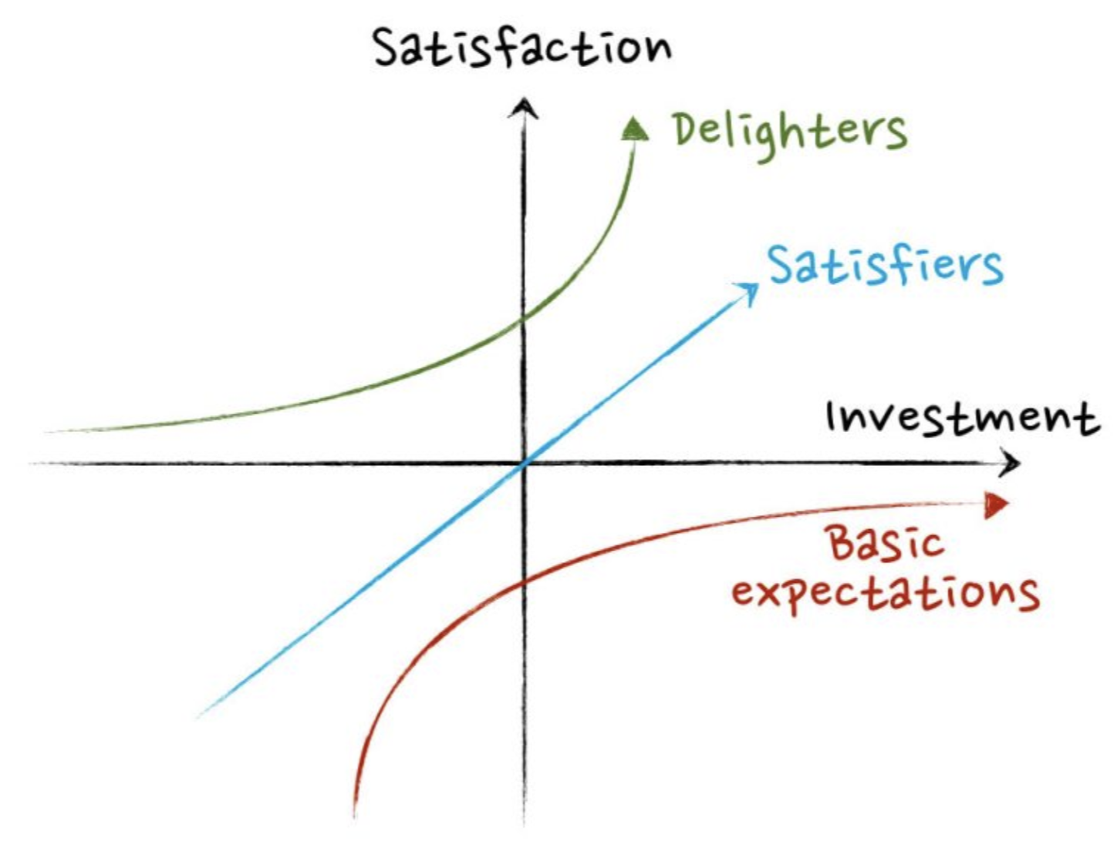
market analysis
BASIC NEEDS
Effective Waking Alarm
Suitable for Bathroom
Clean
DELIGHTERS
Music Player
Weather Report
Toothpaste Squeezer
Reminder
Consumption Analysis
PERFORMANCE FACTORS
Storage: Quick-Fetch
Material: Waterproof
Cleanness: UV Disinfection

Slide 14
business canvas
Key partners: Hotels, Retail Stores Key suppliers: Manufacturers of the UV lamp, battery, electronic components etc; customized shell manufacturer Consumptions: Toothpaste producer | Key Activities Marketing, Production, App Development, Logistics, Feedback survey, Improvement | Value propositions: deliver IoT solutions for waking up efficiently and keeping the basin clean |  | Customer Relationships Remarks on E-commerce platforms; Self-media advertising Hotel promoting | Customers Office workers: living alone or with a partner; Busy but want to be healthy; Limited living space. Students: living in dorm that owns/ shares bathroom with another one Hotels
 | Key Resources Mainly high-end markets: villas (retail, engineering), smart communities (engineering) Growing markets: smart hotels (engineering) and smart offices (engineering), but slowest in the smart home (retail) market.
 | Key Resources Mainly high-end markets: villas (retail, engineering), smart communities (engineering) Growing markets: smart hotels (engineering) and smart offices (engineering), but slowest in the smart home (retail) market. |  |  | Channels Both E-commerce platforms and Hypostatic stores
Cost structures Cost of R&D: CMF & Engineering Design Cost of Goods: Material & Manufacture Cost of sales: Advertising, Licensing, Inventory Depreciation, Logistics … |  |  | Revenue Streams App Revenue Sales from E-commerce platforms Sales from Hypostatic stores Sales from Hotel Corporations

Slide 15
Future expects – tech trends
2018-2023
1.5 tri ¥
2020 20%
Today 4SSteps
intelligent rate of living appliances
total market demand of smart appliances
smart object revolution
Sensorial, Systematic, Self, Shared

Slide 16
business plan
IoT needs
prototype
engineering sample
small batch
and development

Slide 17

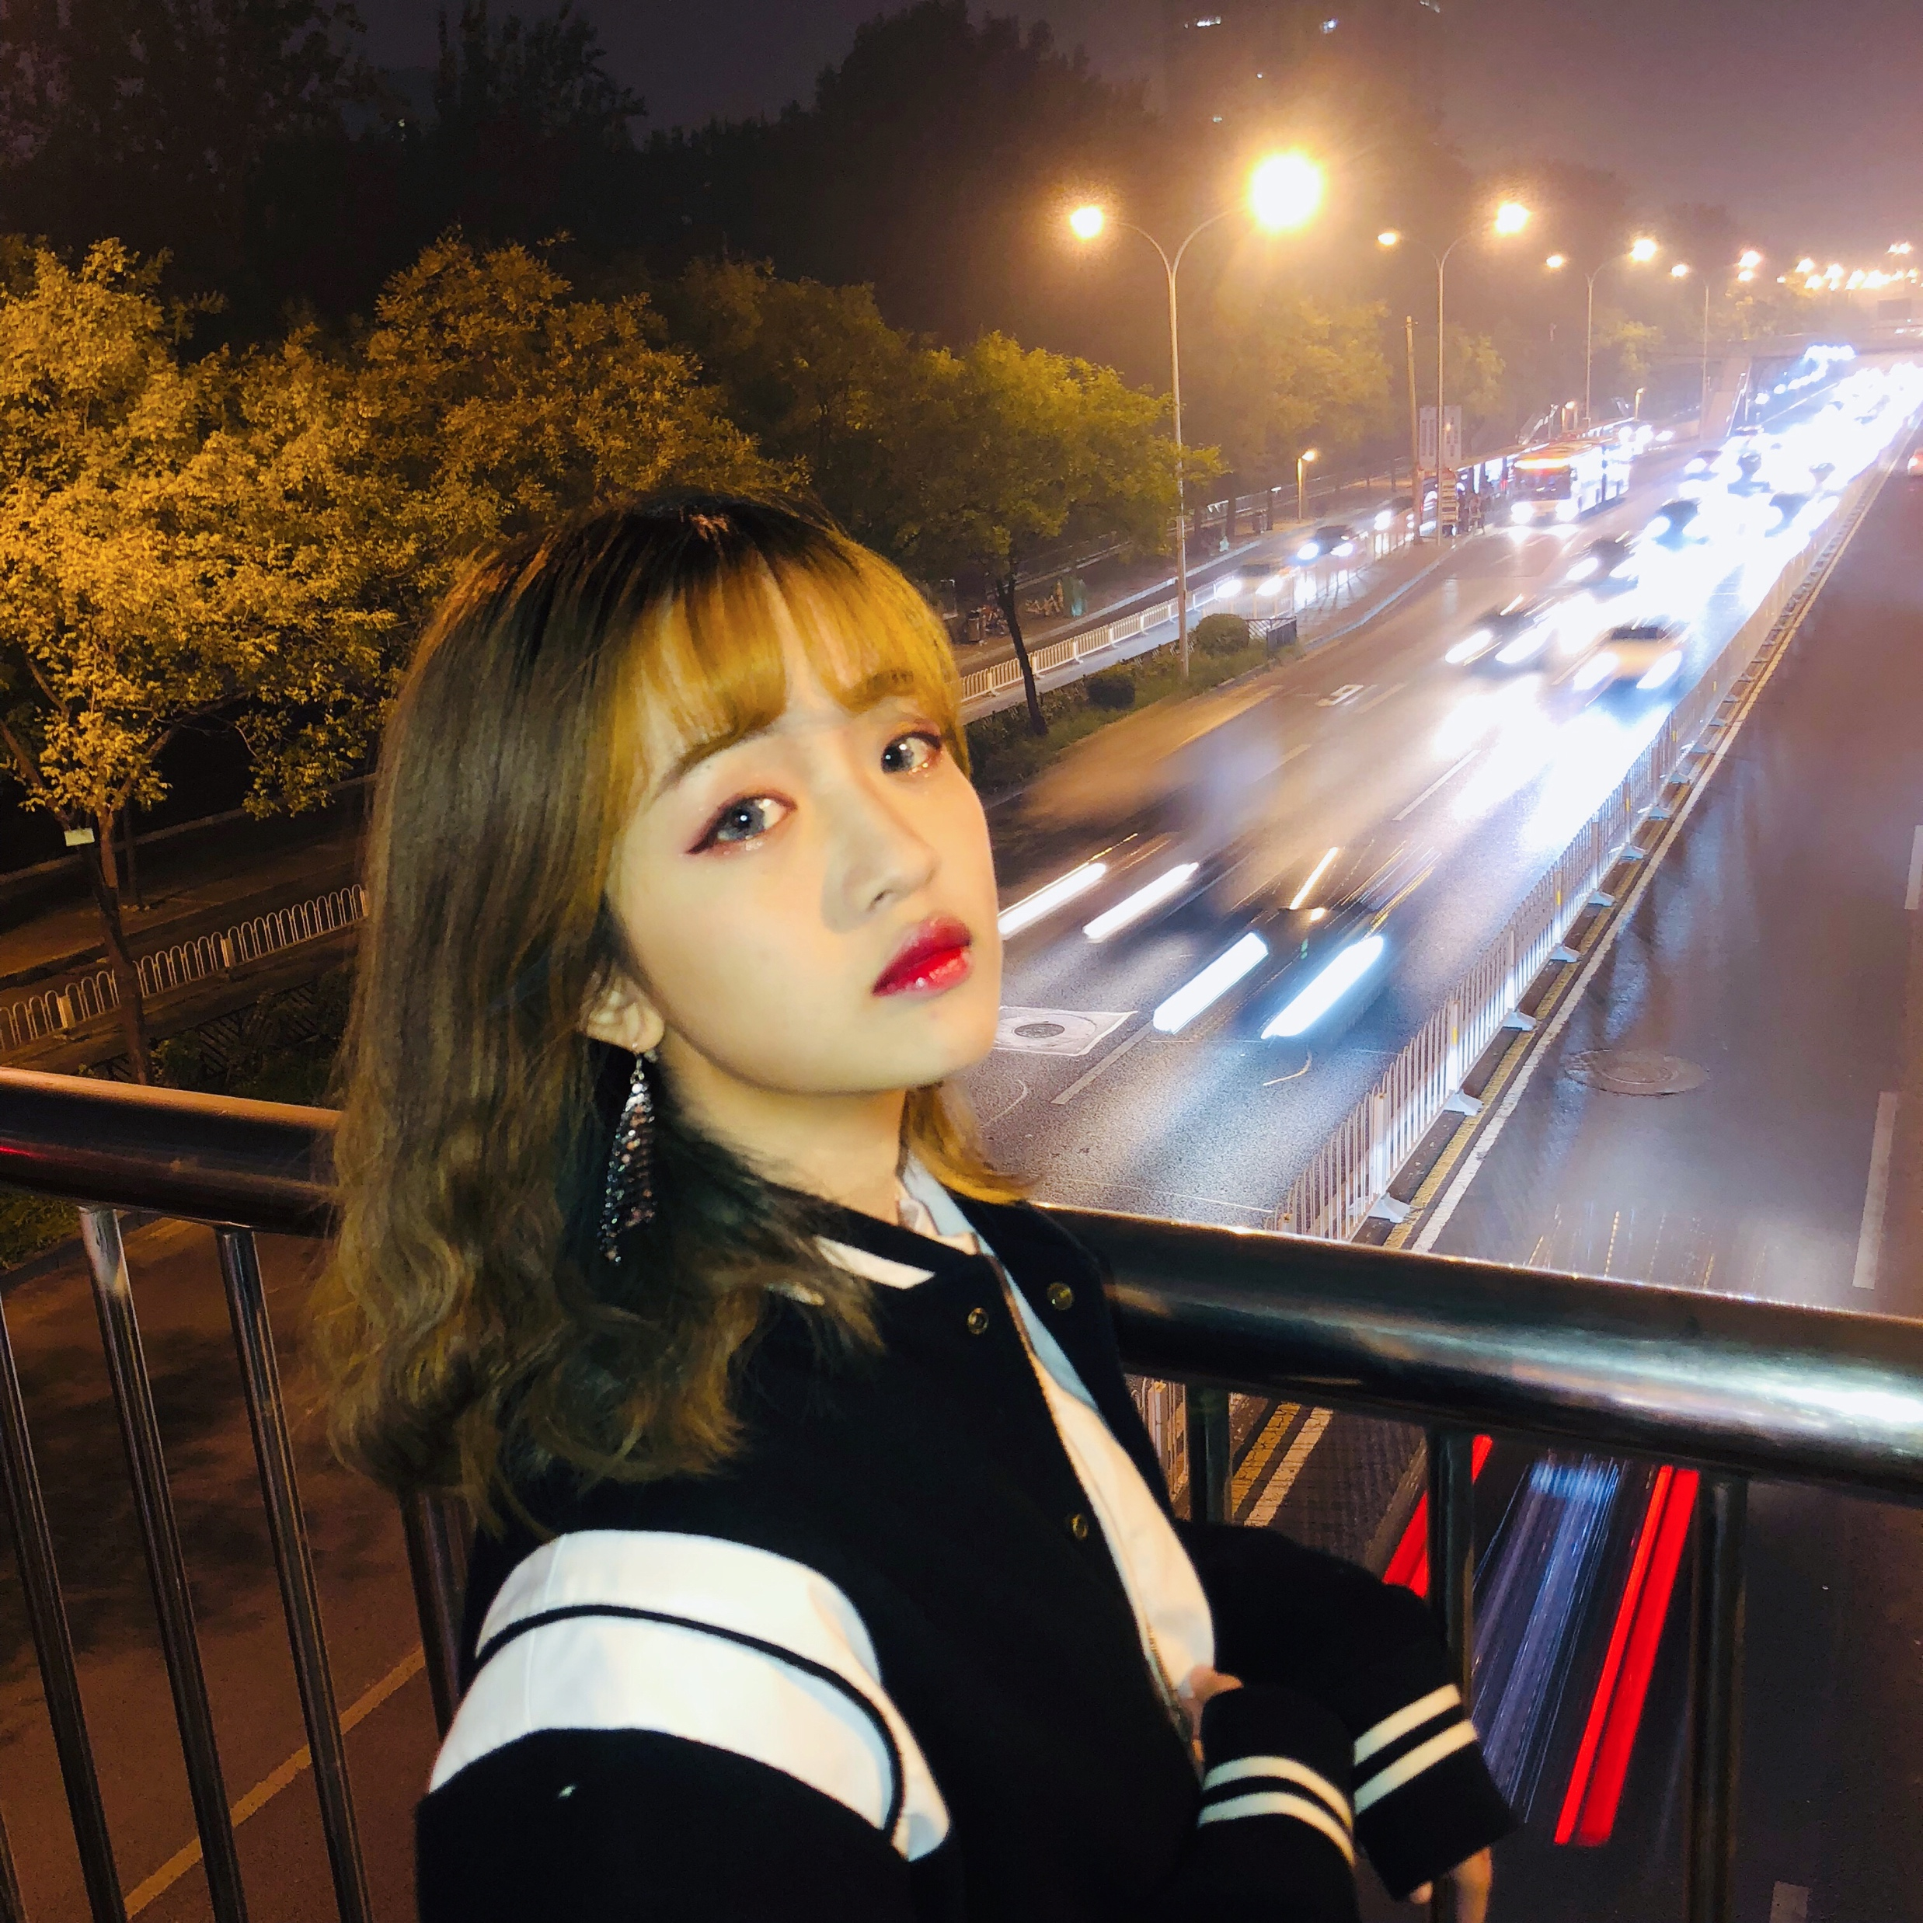
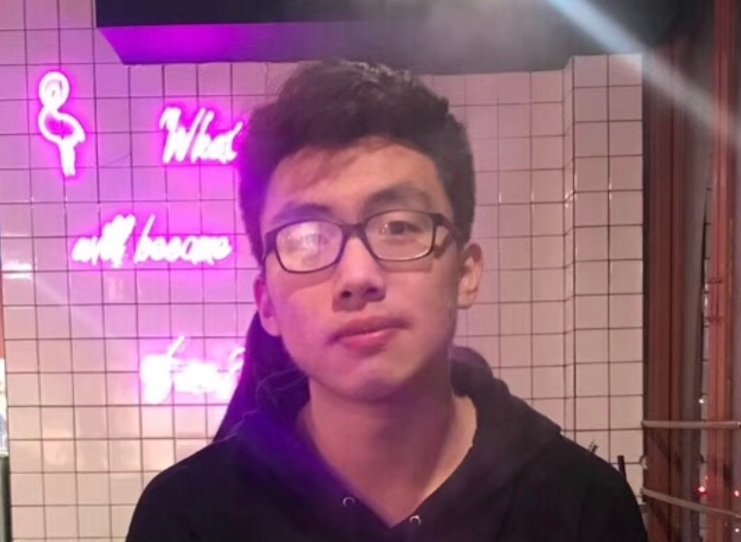
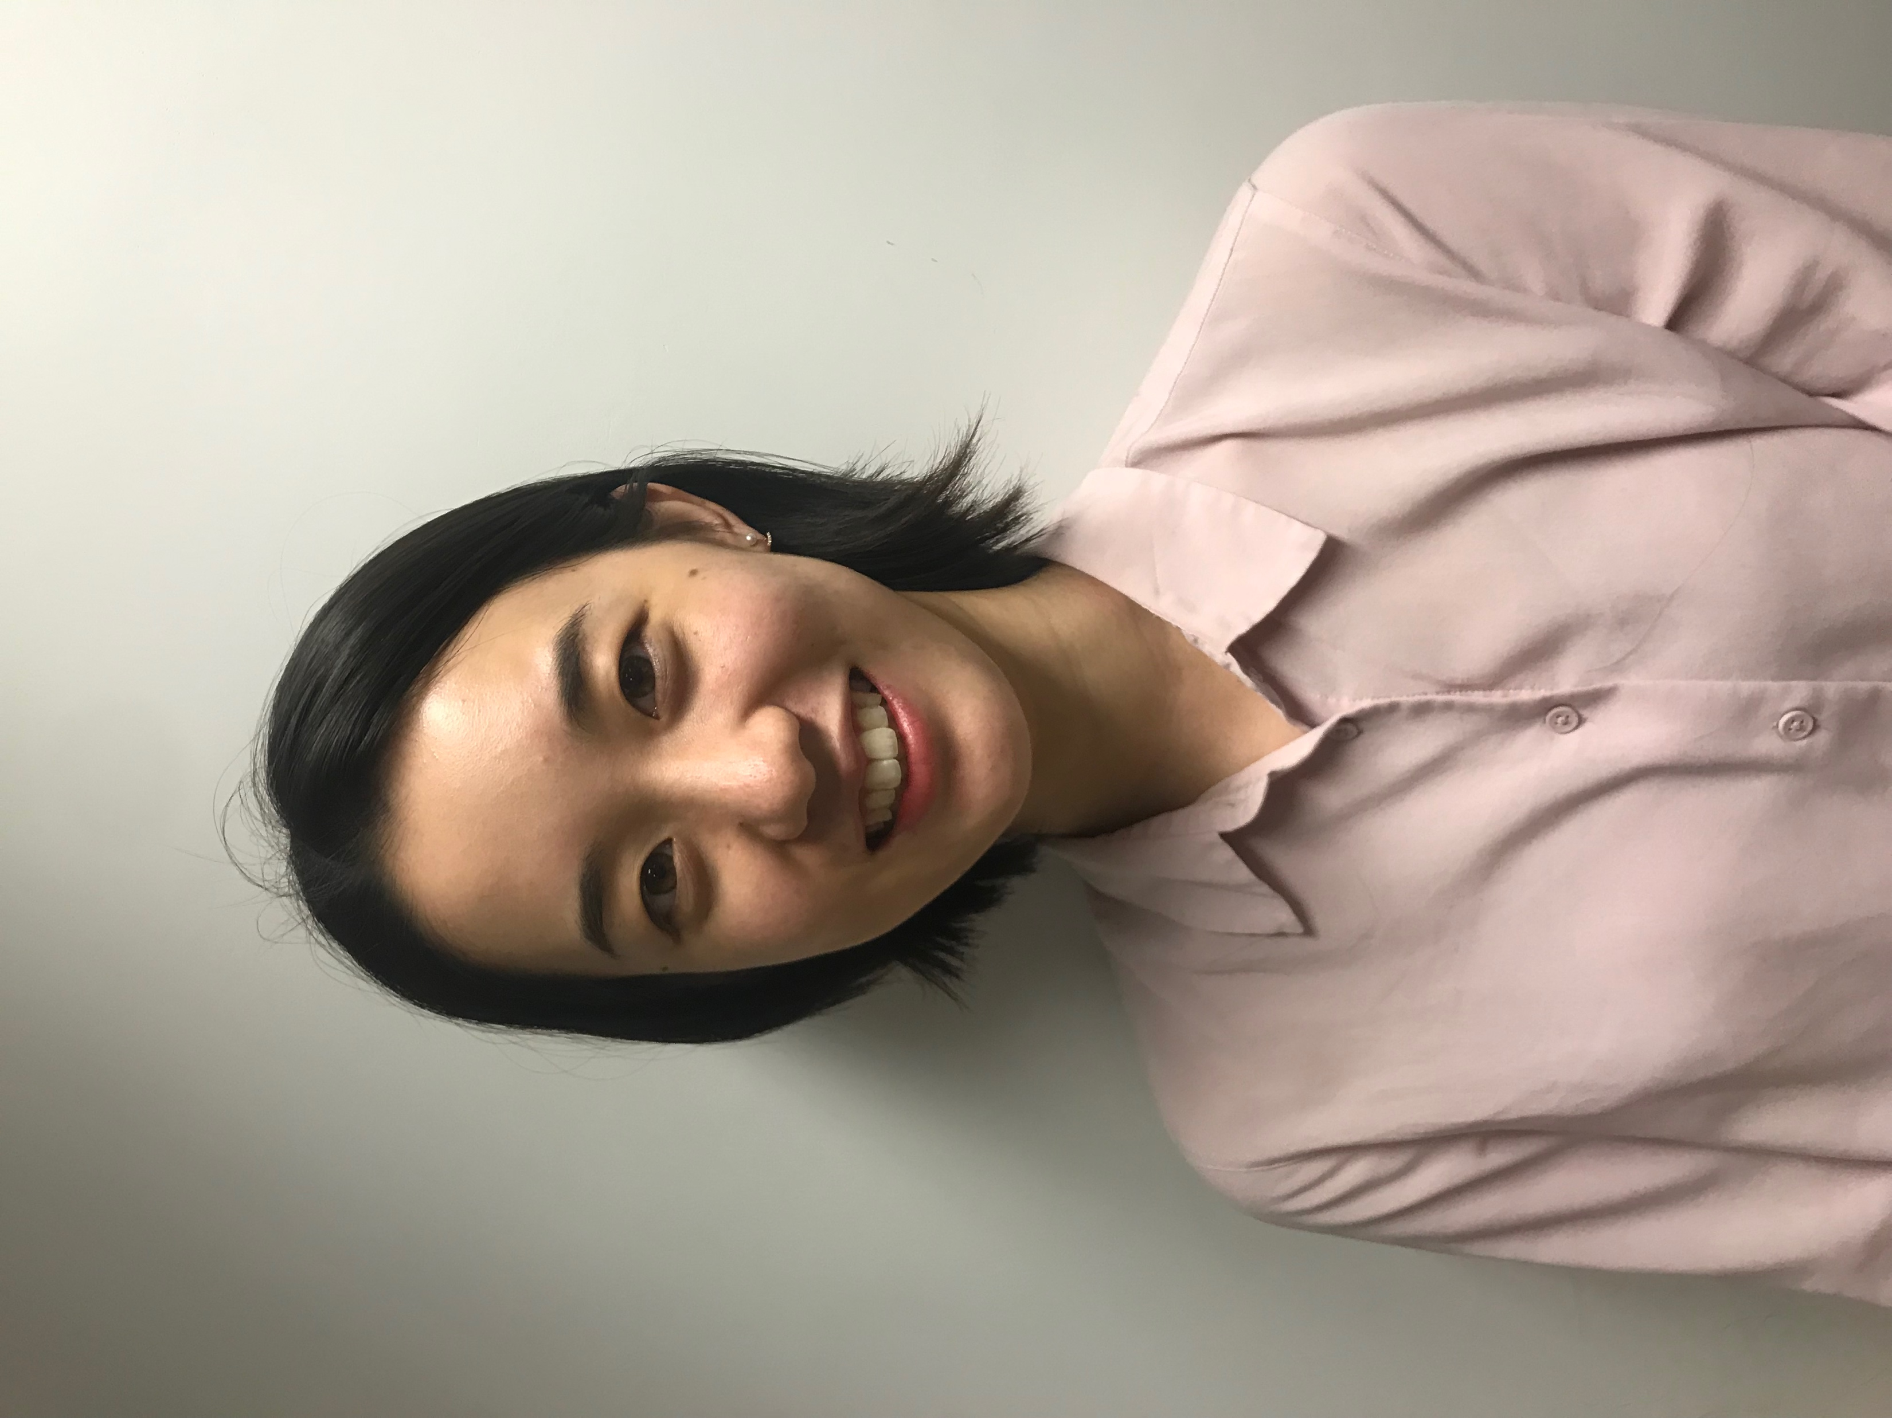
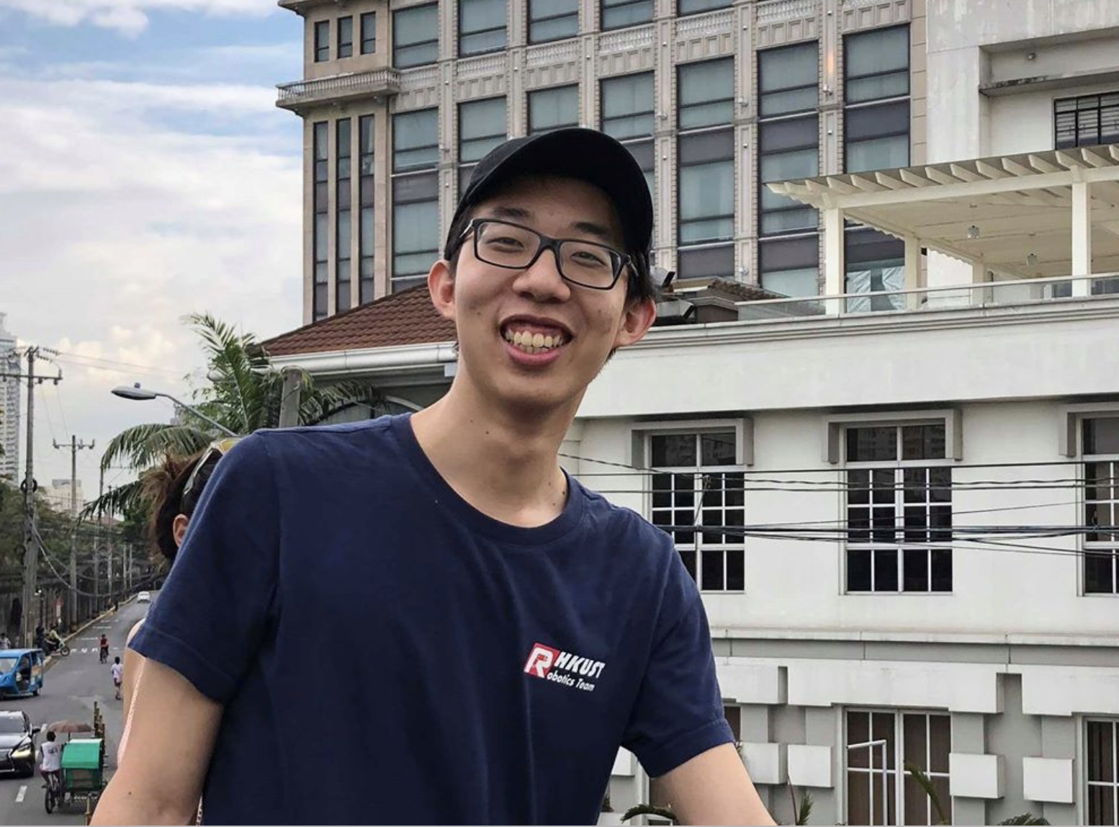
Hongyu Chen
Jingwen Ma
Mengyu Li
Team Leader
Graphics & Poster Design
Video Making
Prototype Production
team members
Yimeng Sun
Dennis Chen
Leaflet & Slides Design
Software Developing
Software Developing

Slide 18
thank you.
WHAT QUESTIONS DO YOU HAVE FOR US?

